Slide 1
Welcome to MF Click

Slide 2
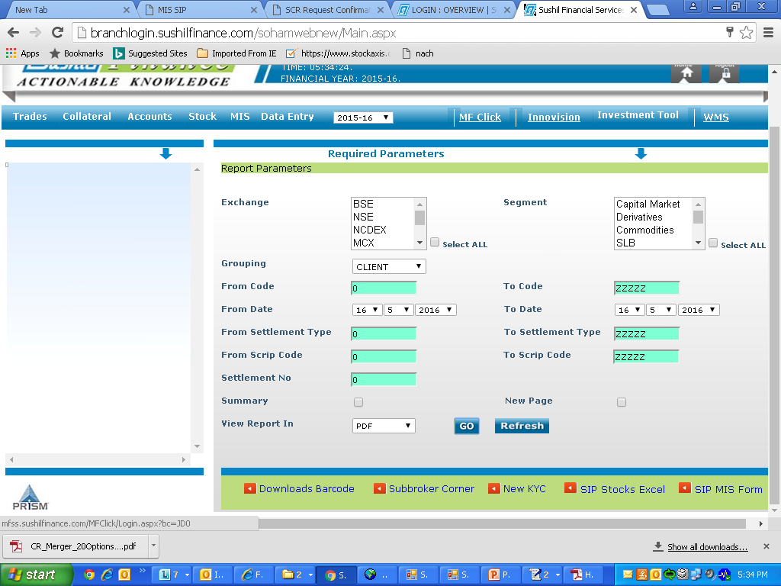
Where to find MF Click?

Slide 3
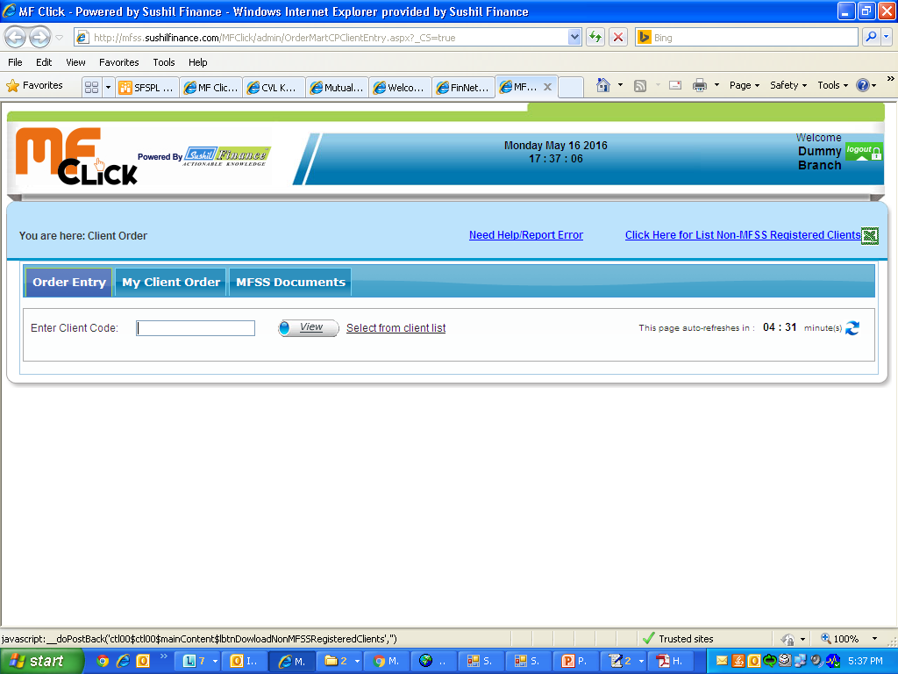
How to check non registered clients

Slide 4
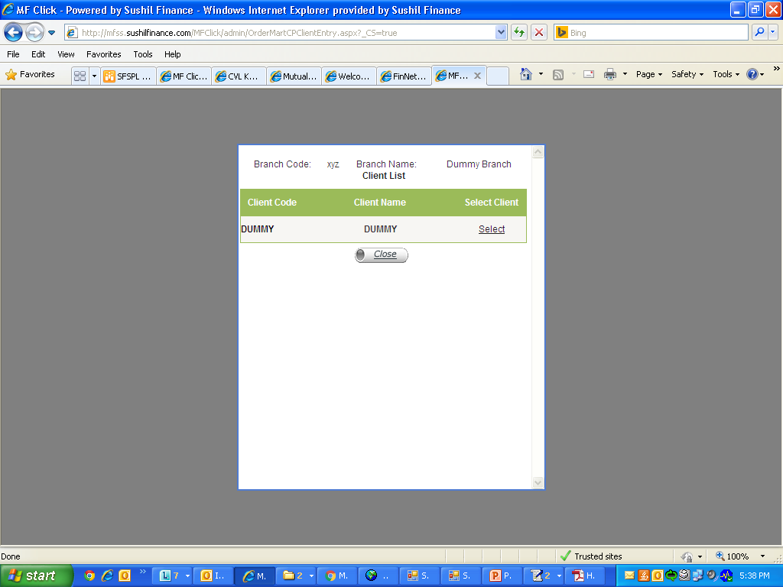
How to select client

Slide 5
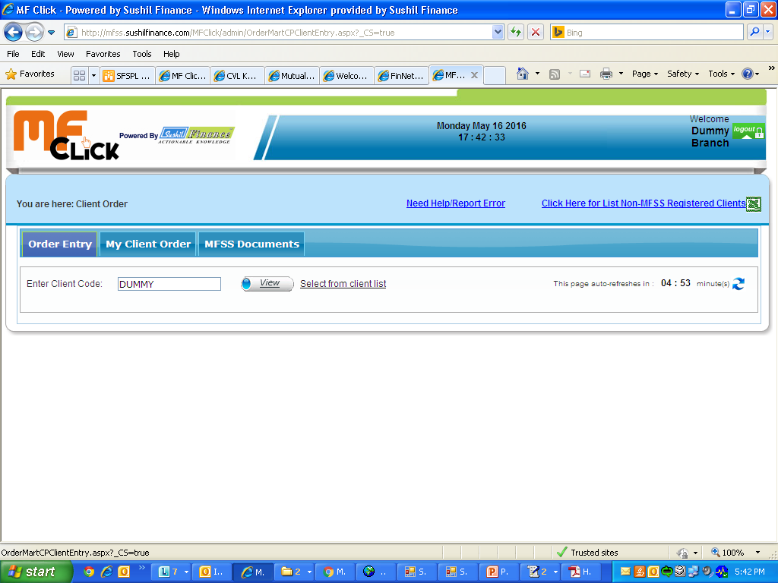
Click on view to get client details

Slide 6
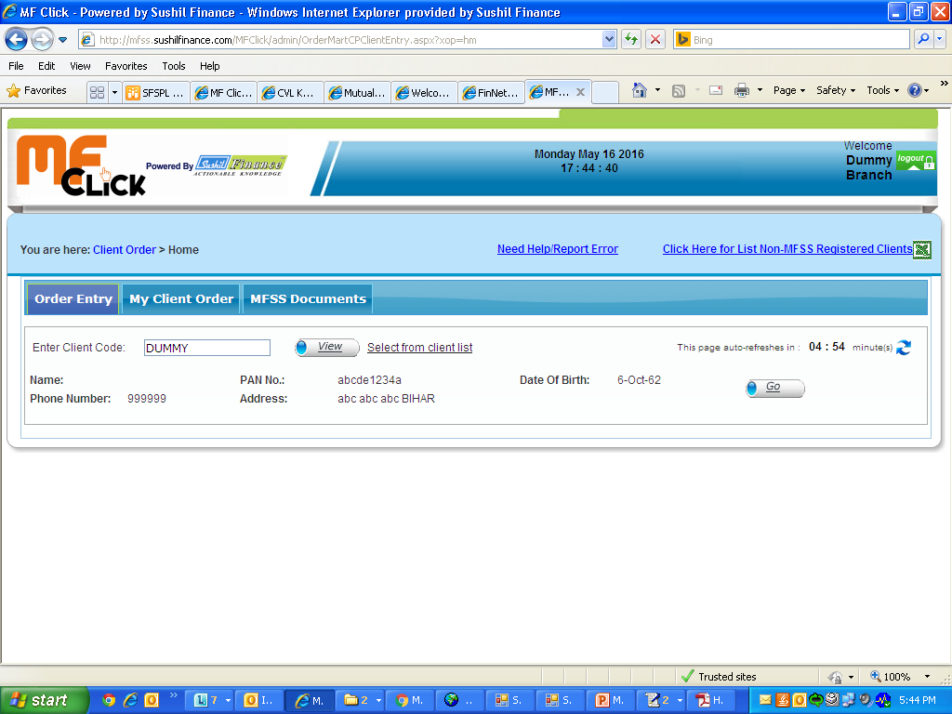
Select on GO

Slide 7
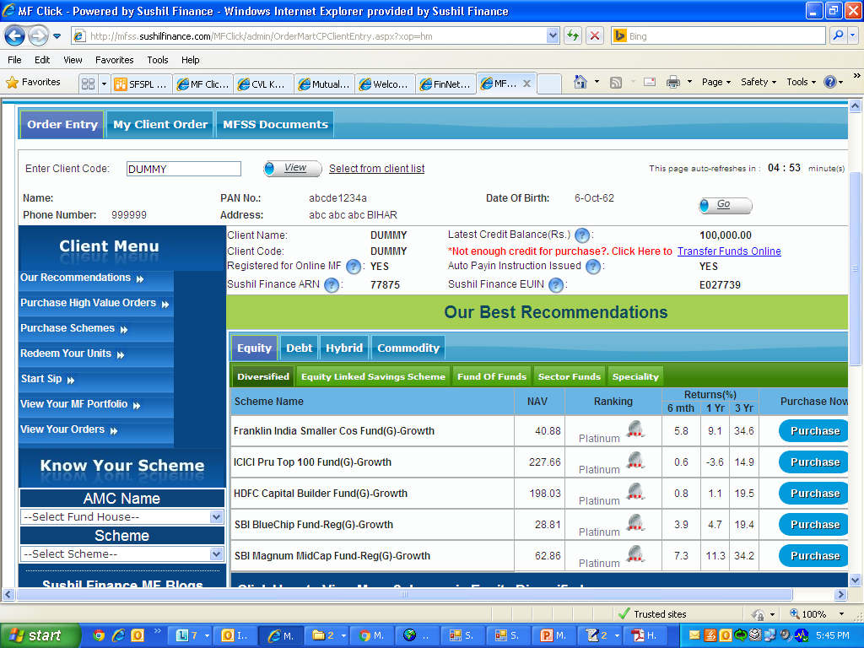
Check MFSS Registration status , Auto Pay in & Balance

Slide 8
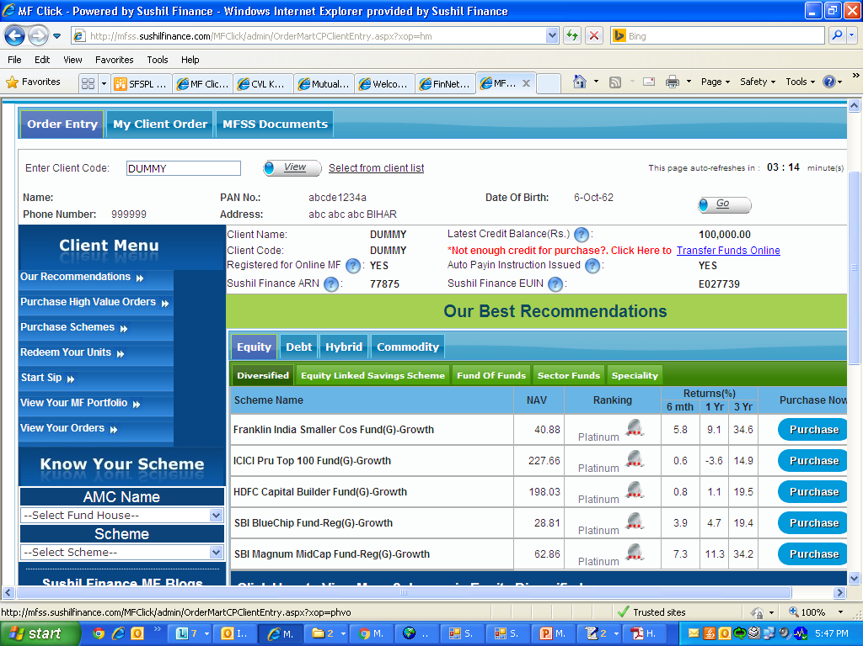
How to Purchase Scheme
Order above Rs.1,99,999 is High Value any order below that is Normal order

Slide 9
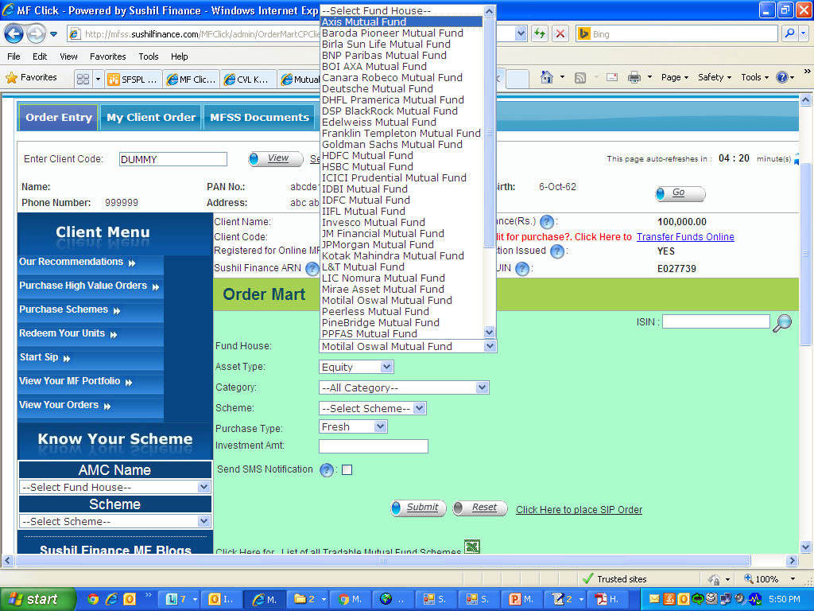
Purchase Order Steps
Time limit for high value order :12.30 pm
Time limit for Normal order :2.00pm

Slide 10
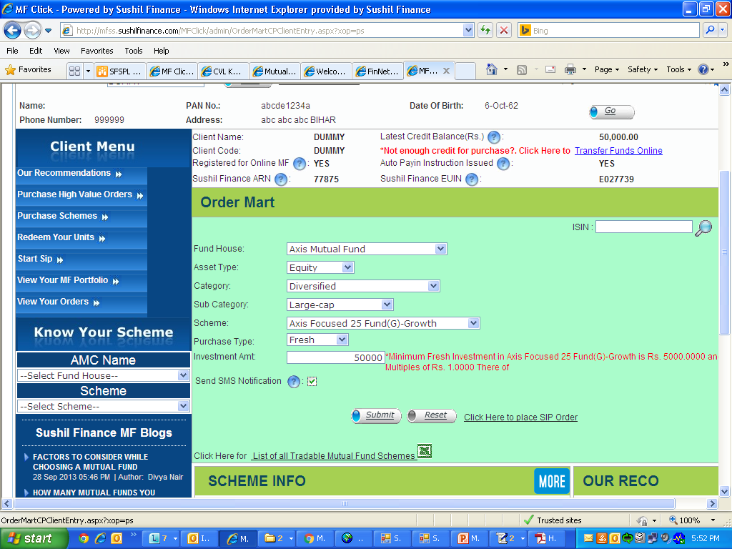
After filling up all details select Submit

Slide 11
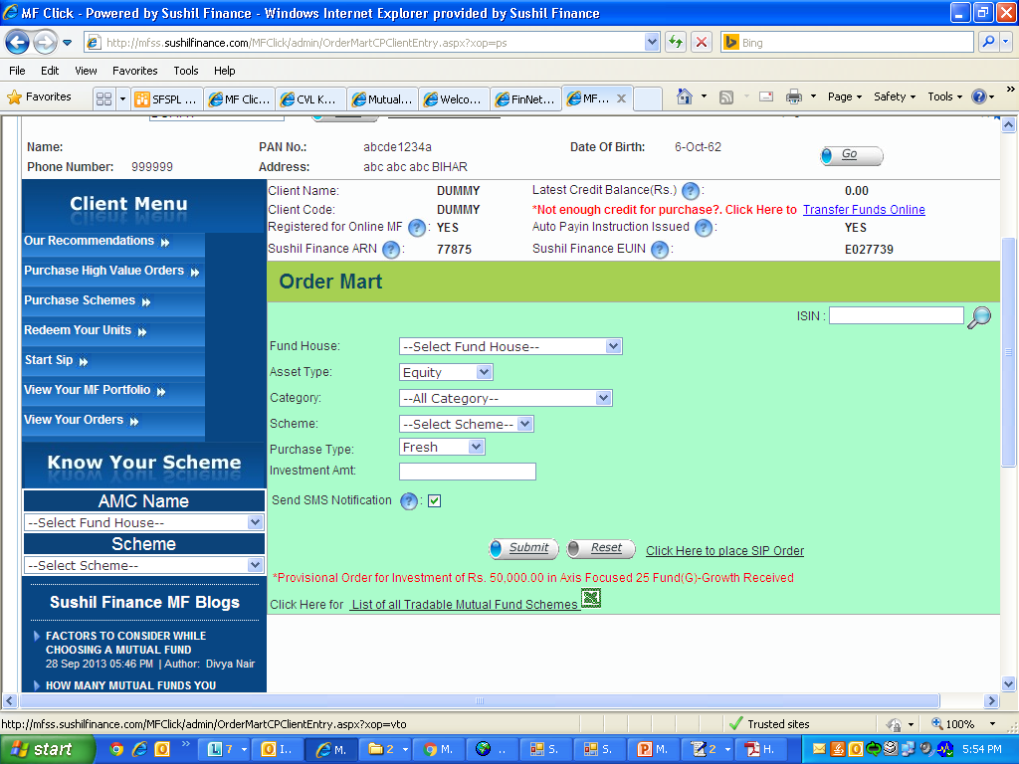
Check for Provisional order Received & then go on view your order

Slide 12
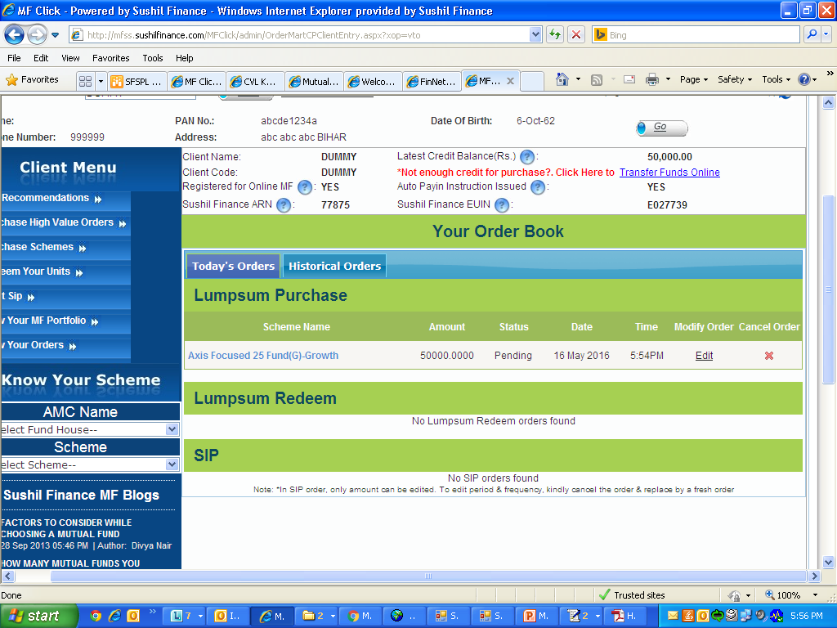
Check order book, here you can edit or delete your order

Slide 13

How to do Redemption

Slide 14
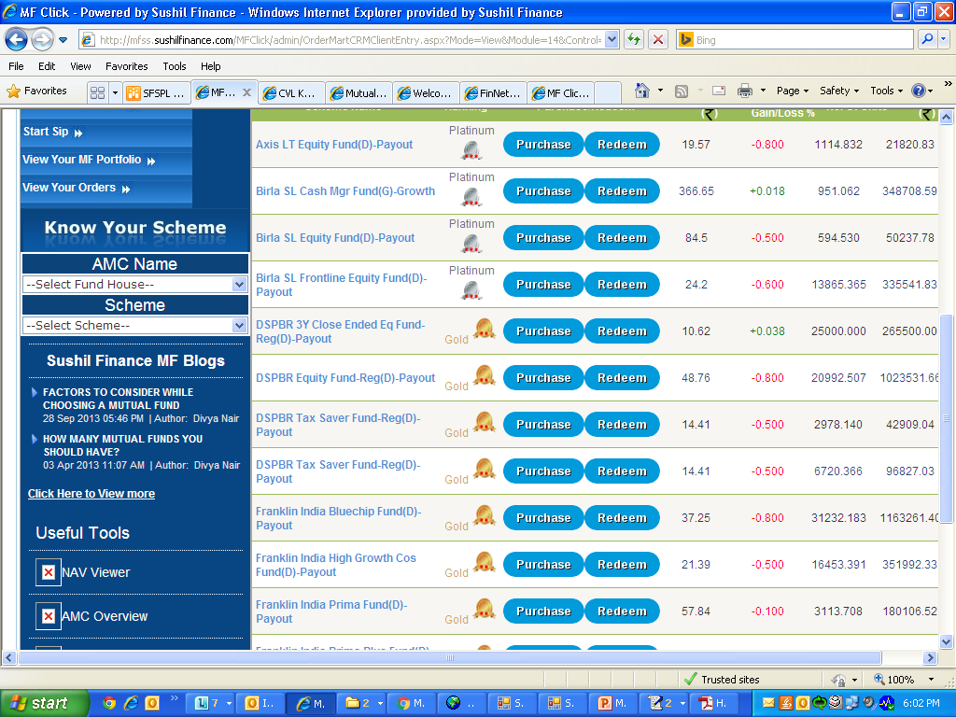
Select on Redeem

Slide 15
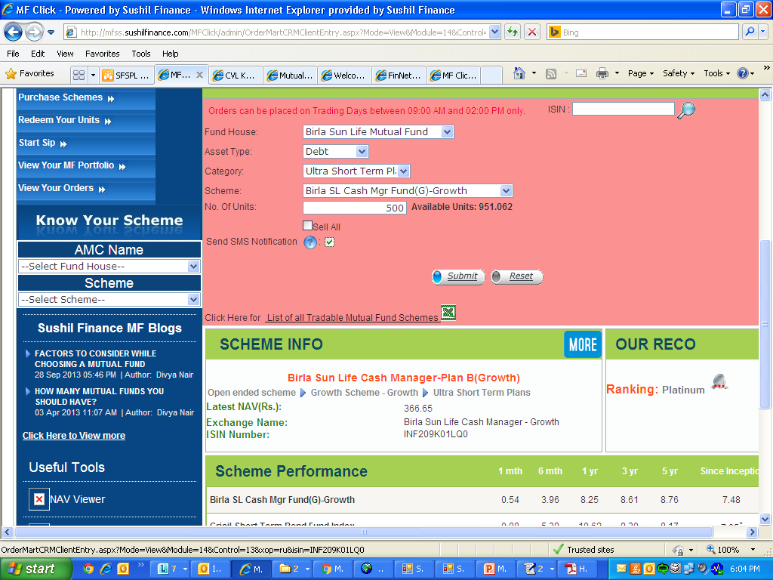
For redemption always mention Units & then submit

Slide 16
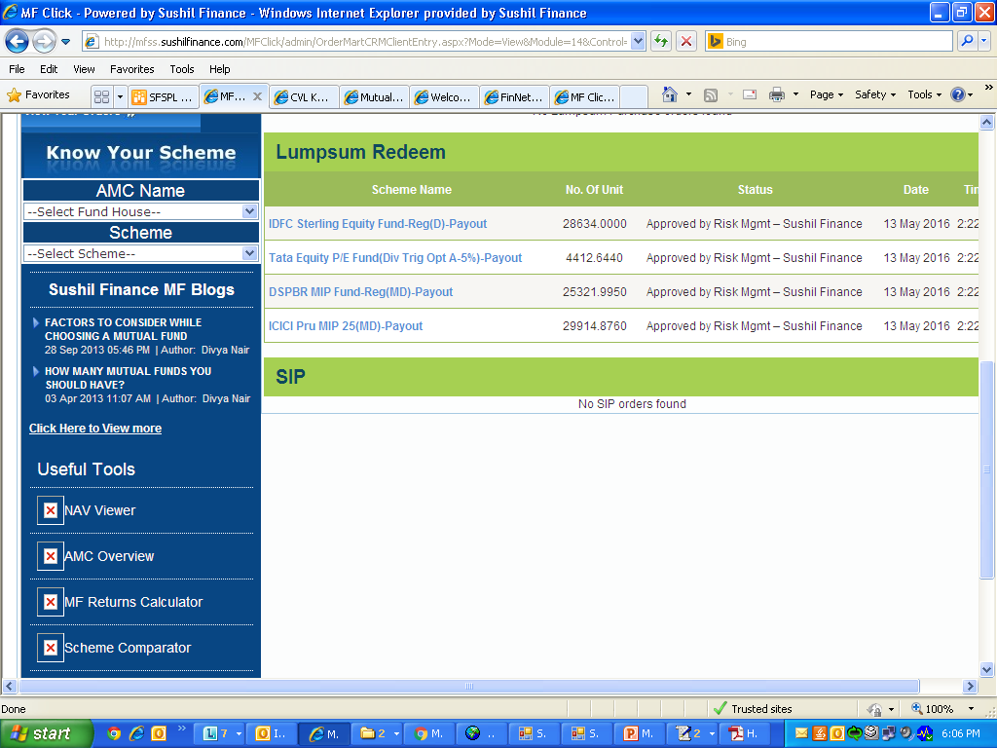
Check order book here you can delete & modify order

Slide 17
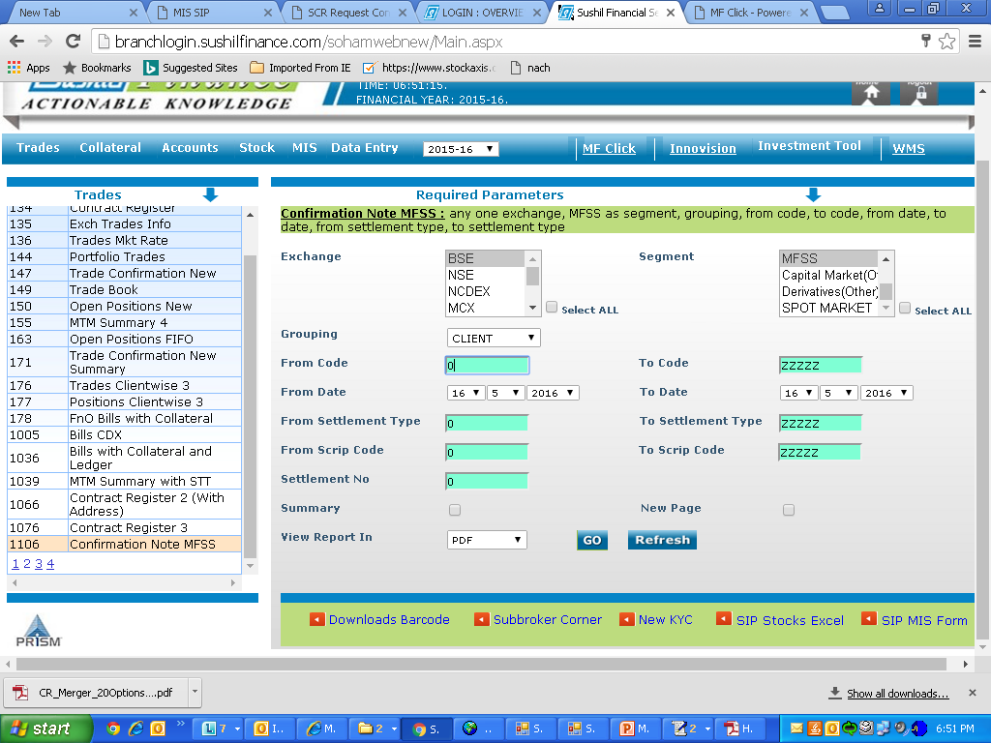
Confirmation note for MFSS report no 1106

Slide 18
              THANK YOU

